Slide 1
Multithreading
Team3

Slide 2
What is Multitasking ?

Slide 3
Multitasking: Executing several tasks simultaneously is the concept of multitasking. There are two types of multitasking's.
1. Process based multitasking.
2. Thread based multitasking

Slide 4
What is multiprocessing

Slide 5
Executing several tasks simultaneously where each task is a separate independent process such type of multitasking is called process based multitasking.
Example: • While typing a java program in the editor we can able to listen mp3 audio songs at the same time we can download a file from the net all these tasks are independent of each other and executing simultaneously and hence it is Process based multitasking.
• This type of multitasking is best suitable at "os level".

Slide 6
What is multithreading ?

Slide 7
Executing several tasks simultaneously where each task is a separate independent part of the same program, is called Thread based multitasking. And each independent part is called a "Thread".

Slide 8
The main important application areas of multithreading are:

Slide 9
1. To implement multimedia graphics
2. To develop animations.
3. To develop video games etc.
4. To develop web and application servers

Slide 10
How can define a Thread .

Slide 11
1. By extending Thread class.
2. By implementing Runnable interface

Slide 12
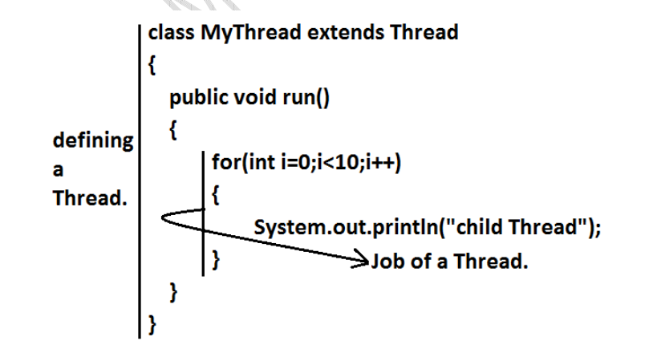
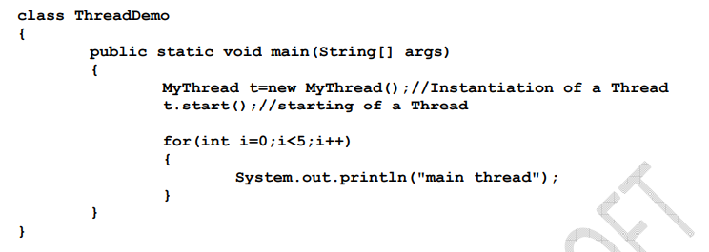
By using Thread()

Slide 13
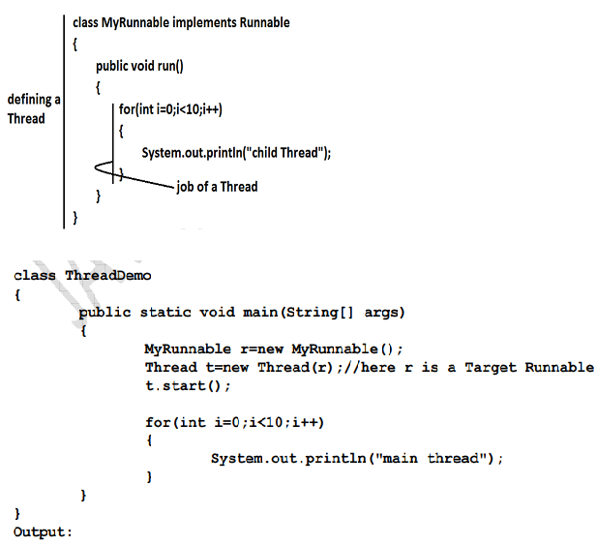
By implementing Runnable

Slide 14
What is Thread Scheduler:

Slide 15
If multiple Threads are waiting to execute then which Thread will execute 1st is decided by "Thread Scheduler" which is part of JVM.

Slide 16
Difference between t.start() and t.run() methods.

Slide 17
In the case of t.start() a new Thread will be created which is responsible for the execution of run() method.
• But in the case of t.run() no new Thread will be created and run() method will be executed just like a normal method by the main Thread.

Slide 18
: If we are not overriding run() method:

Slide 19
class MyThread extends Thread {
}
class ThreadDemo
{
public static void main(String[] args)
{
MyThread t=new MyThread();
t.start();
}
}
Output :
If we are not overriding run() method then Thread class run() method will be executed which has empty implementation and hence we won't get any output.

Slide 20
Overloding of run() method.

Slide 21
class MyThread extends Thread
{
public void run()
{
System.out.println("no arg method");
}
public void run(int i)
{
System.out.println("int arg method");
}
}
class ThreadDemo
{
public static void main(String[] args) {
MyThread t=new MyThread();
t.start();
}
}
Output: No arg method
We can overload run() method but Thread class start() method always invokes no argument run() method the other overload run() methods we have to call explicitly then only it will be executed just like normal method.

Slide 22
overriding of start() method

Slide 23
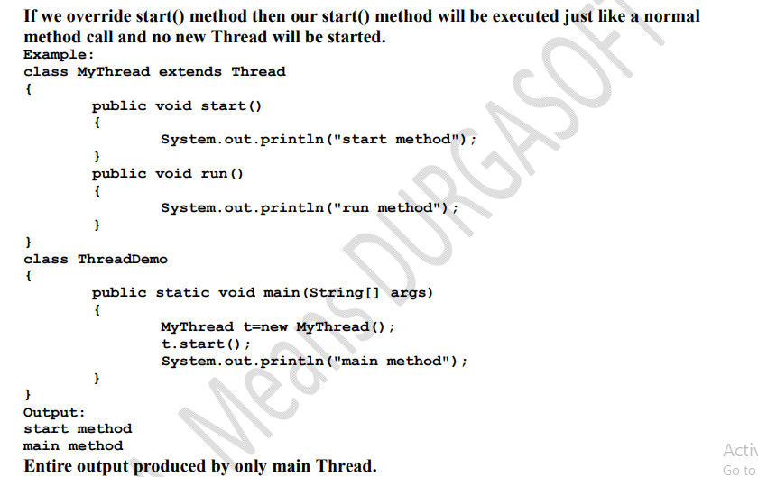

Slide 24
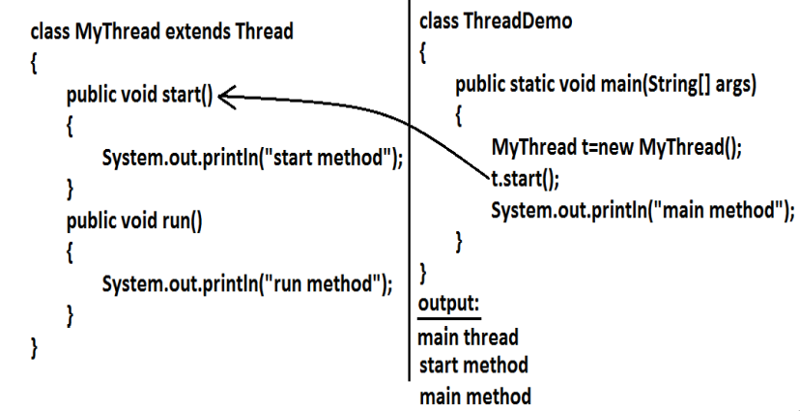

Slide 25
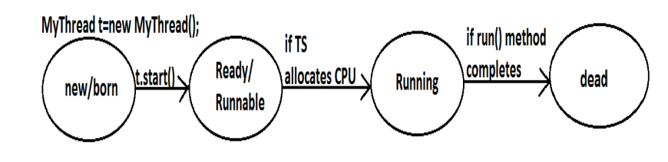
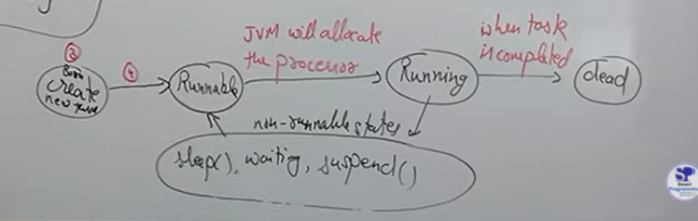
Life cycle of thread

Slide 26
IllegalThreadStateException when it raises

Slide 27
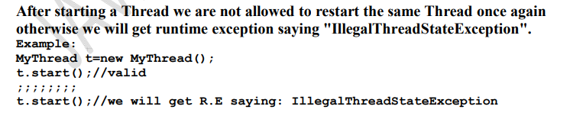

Slide 28
Which is one is the best practice for thread Thread class or Runnable interface

Slide 29
Among the 2 ways of defining a Thread, implements Runnable approach is always recommended.
• In the 1st approach our class should always extends Thread class there is no chance of extending any other class hence we are missing the benefits of inheritance.
• But in the 2nd approach while implementing Runnable interface we can extend some other class also. Hence implements Runnable mechanism is recommended to define a Thread.

Slide 30
Thread Constructor()
1. Thread t=new Thread();
2. Thread t=new Thread(Runnable r);
3. Thread t=new Thread(String name);
4. Thread t=new Thread(Runnable r,String name);
5. Thread t=new Thread(ThreadGroup g,String name);
6. Thread t=new Thread(ThreadGroup g,Runnable r);
7. Thread t=new Thread(ThreadGroup g,Runnable r,String name);
8. Thread t=new Thread(ThreadGroup g,Runnable r,String name,long stackSize);

Slide 31
Methods: 1. public final String getName() 2. public final void setName(String name)
class MyThread extends Thread {
}
class ThreadDemo
{
public static void main(String[] args) {
System.out.println(Thread.currentThread().getName());
//main
MyThread t=new MyThread(); System.out.println(t.getName());
//Thread-0
Thread.currentThread().setName("Bhaskar Thread");
System.out.println(Thread.currentThread().getName());
//Bhaskar Thread } }

Slide 32
Thread Priority constant
Thread class defines the following constants to represent some standard priorities.
1. Thread. MIN_PRIORITY----------1
2. Thread. MAX_PRIORITY----------10
3. Thread. NORM_PRIORITY--------5
Valid Range of priority 1 to 10
1 least
10 Highest

Slide 33
The Methods to Prevent a Thread from Execution:
1. yield(); Shopping Mall
2. join();
3. sleep();

Slide 34
yield():
1. yield() method causes "to pause current executing Thread for giving the chance of remaining waiting Threads of same priority".
2. If all waiting Threads have the low priority or if there is no waiting Threads then the same Thread will be continued its execution.
3. If several waiting Threads with same priority available then we can't expect exact which Thread will get chance for execution.
4. The Thread which is yielded when it get chance once again for execution is depends on mercy of the Thread scheduler.
5. public static native void yield();

Slide 35
Join():
If a Thread wants to wait until completing some other Thread then we should go for join() method.
Example: If a Thread t1 executes t2.join() then t1 should go for waiting state until completing t2.

Slide 36
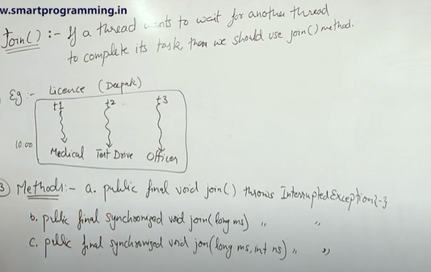

Slide 37
1. public final void join()throws InterruptedException
2. public final void join(long ms) throws InterruptedException
3. public final void join(long ms,int ns) throws InterruptedException

Slide 38
Sleep() method:
If a Thread don't want to perform any operation for a particular amount of time then we should go for sleep() method.
1. public static native void sleep(long ms) throws InterruptedException
2. public static void sleep(long ms,int ns)throws InterruptedException

Slide 39
public class SleepMethod {
public static void main(String[] args)throws InterruptedException
{
System.out.println("M");
Thread.sleep(3000);
System.out.println("E");
Thread.sleep(3000);
System.out.println("G");
Thread.sleep(3000);
System.out.println("A");
}
}

Slide 40
Interrupting a Thread:

Slide 41
How a Thread can interrupt another thread ? If a Thread can interrupt a sleeping or waiting Thread by using interrupt()(break off) method of Thread class. public void interrupt();

Slide 42
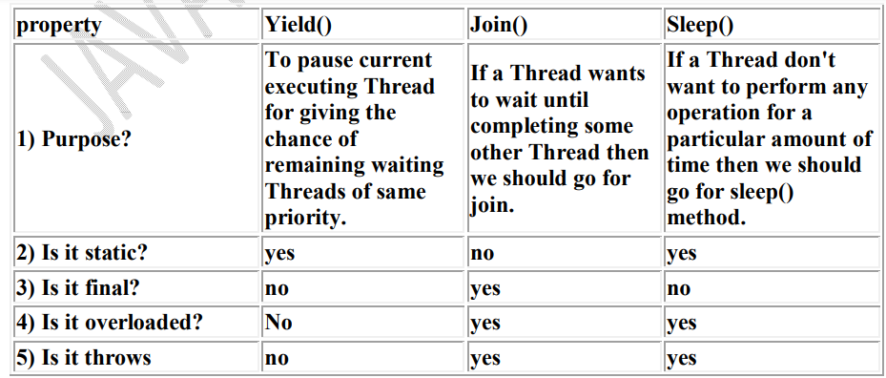
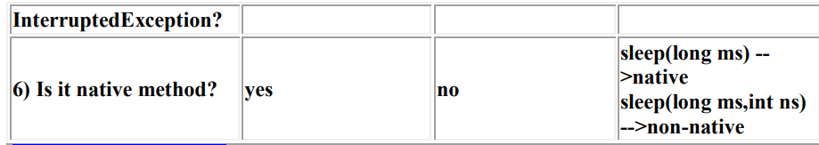

Slide 43
Synchronization

Slide 44
1. Synchronized is the keyword applicable for methods and blocks but not for classes and variables.
2. If a method or block declared as the synchronized then at a time only one Thread is allow to execute that method or block on the given object.
3. The main advantage of synchronized keyword is we can resolve date inconsistency problems.
4. But the main disadvantage of synchronized keyword is it increases waiting time of the Thread and effects performance of the system.

Slide 45
5. Hence if there is no specific requirement then never recommended to use synchronized keyword.
6. Internally synchronization concept is implemented by using lock concept.
7. Every object in java has a unique lock. Whenever we are using synchronized keyword then only lock concept will come into the picture.

Slide 46
8. If a Thread wants to execute any synchronized method on the given object 1st it has to get the lock of that object. Once a Thread got the lock of that object then it's allow to execute any synchronized method on that object. If the synchronized method execution completes then automatically Thread releases lock.
9. While a Thread executing any synchronized method the remaining Threads are not allowed execute any synchronized method on that object simultaneously. But remaining Threads are allowed to execute any non-synchronized method simultaneously. [lock concept is implemented based on object but not based on method].

Slide 47
Conclusion : If multiple threads are operating on multiple objects then there is no impact of Syncronization. If multiple threads are operating on same java objects then syncronized concept is required(applicable).

Slide 48
1.Explain about synchronized keyword and its advantages and disadvantages?
2. What is object lock and when a Thread required?
3. What is class level lock and when a Thread required?
4. What is the difference between object lock and class level lock?
5. While a Thread executing a synchronized method on the given object is the remaining Threads are allowed to execute other synchronized methods simultaneously on the same object? Ans: No.
6. What is synchronized block and explain its declaration? 7. What is the advantage of synchronized block over synchronized method?
8. Is a Thread can hold more than one lock at a time? Ans: Yes, up course from different objects. Example:

